Slide 1
Memory Management in .Net
September 9, 2016

Slide 2
Agenda
Garbage Collection

Slide 3
Garbage Collection

Slide 4
Garbage Collection
In and Out of Garbage Collector
GC in .Net Framework
How GC works?
Different GC algorithms
Mark sweep GC
Generational GC
Finalization Vs. Dispose
Some tips on being friendly to GC
Garbage collection Visualization
CLR Profiler
Process Explorer

Slide 5
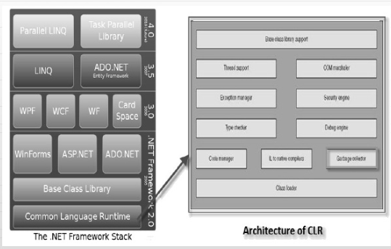
GC in .NET Framework

Slide 6
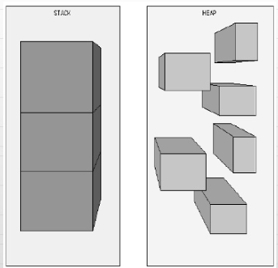
Stack Vs.Heap
The Stack is more less responsible for keeping track of what’s executing in our code (or what’s being called)
The Heap is more or less responsible for keeping track of our objects (our data..)

Slide 7
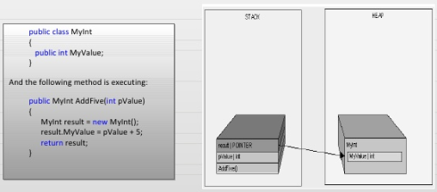
How it is decided what goes where?
Two golden rules
Reference type always goes on Heap
Value type and Pointers always goes where they are declared

Slide 8
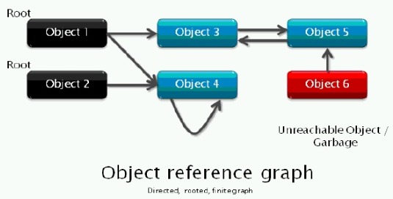
Terminology
How are the objects laid out in memory heap

Slide 9
When/How GC runs
System is low in memory
Memory is too much fragmented
After quanta of allocation
There are multiple types of Garbage Collectors available
Mark sweep GC
Generational GC
Copying GC
Reference counting GC

Slide 10
Mark - Sweep GC
Algorithm
Traverse the entire memory graph starting from roots
Mark objects that are visited
Sweep (remove) all objects that are not visited
Compact

Slide 11
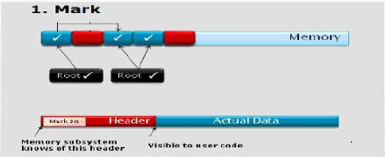
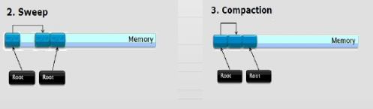
Mark - Sweep in Action

Slide 12
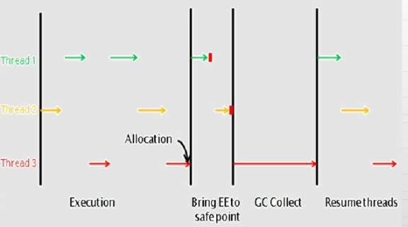
GC – Save Point

Slide 13
Compaction
Done to
Decrease fragmentation
Increase allocation speed
Increase locality of reference
Run based on fragmentation
Need to strike balance as compaction is very costly
Elaborate language/platform support required

Slide 14
Generational GC
Detailed Algorithms
Segregate objects by age into multiple generations
Younger generation is allocated often
Failure to collect or age promotes them to higher generation
Higher generation is rarely collected
.Net and some implementations of ML, Lisp, Haskell, Smalltalk

Slide 15
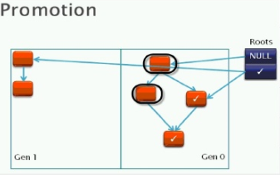
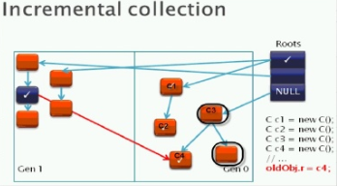
Promotion and Incremental Collection

Slide 16
Copy Collection
Instead of just marking as we trace
Copy each reachable object to new part of heap
Needs to have enough space to do this
No need for second pass
Advantages
one pass
compaction
Disadvantages
higher memory requirements

Slide 17
C# Memory management
Related to next-fit, copy-collector
keep a NextObjPointer to next free space
use it for new objects until no more space
Keep knowledge of Root objects
global and static object pointers
all thread stack local variables
registers pointing to objects
maintained by JIT compiler and runtime
E.g. JIT keeps a table of roots

Slide 18
C# Memory management
On traversal:
walk from roots to find all good objects
linear pass through heap
on gap, compact higher objects down
fix object references to make this work
very fast in general
Speedups:
assume different types of objects

Slide 19
Generations
Current .NET uses 3 generations:
0 – recently created objects: yet to survive GC
1 – survived 1 GC pass
2 – survived more than 1 GC pass
Assumption: longer lived implies live longer
Is this a good assumption?
good assumption for many applications
and for many systems (eg. P2P)
Put lower objects lower in heap

Slide 20
Generations
During compaction, promote generations
eg. Gen 1 reachable object goes to Gen 2
Eventually:
}
Generation 0
}
Generation 1
}
Generation 2
Heap

Slide 21
Object Pinning
Can require that an object not move
could hurt GC performance
useful for unsafe operation
in fact, needed to make pointers work
syntax:
fixed(…) { … }
will not move objects in the declaration in the block

Slide 22
Finalization
Recall C++ destructors: ~MyClass() { // cleanup }
called when object is deleted
does cleanup for this object
Don’t do this in C# (or Java)
similar construct exists
but only called on GC
no guarantees when

Slide 23
Finalization
More common idiom: public void Finalize() { base.Finalize(); Dispose(false); }
maybe needed for unmanaged resources
slows down GC significantly
Finalization in GC:
when object with Finalize method created
add to Finalization Queue
when about to be GC’ed, add to Freachable Queue

Slide 24
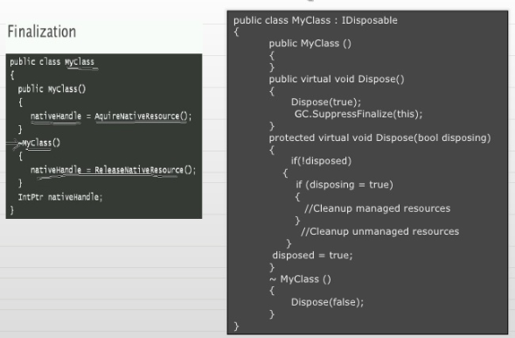
Finalization Vs. Dispose

Slide 25
Some tips of being friendly to GC
Avoid object pools
Do NOT use GC.Collect()
Be careful about un-intended object creation
Finalization
Be careful about large objects (> 85000 B)
Pinning is bad for GC performance
Set reference to null as soon as you can see specially before blocking
Weak References

Slide 26
Garbage Collection Visualizations
CLR Profiler
Process Explorer

Slide 27

Thank You!
Prashant Kulkarni
Technical Lead
Mobile: +91 9890913122
Desk: +91 20 66046341
Prashant.kulkarni@xoriant.com
www.xoriant.com
India
Mumbai
4th Floor, Nomura
Powai , Mumbai 400 076
Pune
5th Floor, Amar Paradigm
Baner, Pune 411 045
Kolkata
2B, 12th Floor, Tower ‘C’
Rajarhat, Kolkata 700 156
US – Corporate Headquarters
1248 Reamwood Avenue,
Sunnyvale, CA 94089
Phone: (408) 743 4400
343 Thornall St 720
Edison, NJ 08837
Phone: (732) 395 6900
UK
20 Broadwick Street
Soho, London
W1F 8HT, UK
89 Worship Street
Shoreditch,
London EC2A 2BF, UK
Phone: (44) 2079 938 955
Bangalore
4th Floor, Kabra Excelsior,
80 Feet Main Road, Koramangala 1st Block,
Bengaluru (Bangalore) 560034
Gurgaon
A/373rd Floor, Sigma Center
Gurgaon, Haryana 122 011s

